Slide 1

Lego
Package
Recognition
COMP6206
Advanced
Computer
Vision
Yaopengfei Lyu 27921832
Li Sun 27536432
Zhenyu Chen 27520129
Lei Zhang 27678385

Slide 2
Flow Chart
Lego Logo Detection & Anti-distortion
Information Cropped
De-noise and Thresholding
Optical Character Recognition(OCR)
CNN Training Dataset
CNN Predict
Combine Result
Box Number Identified

Slide 3
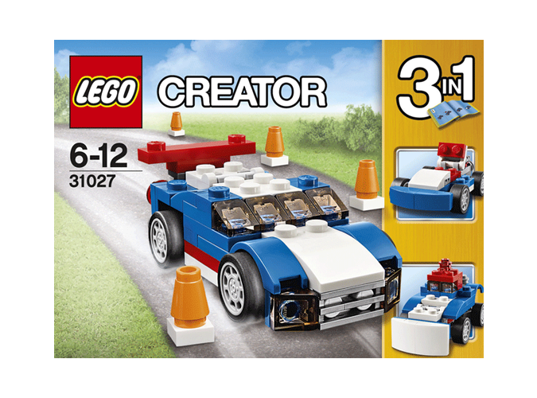
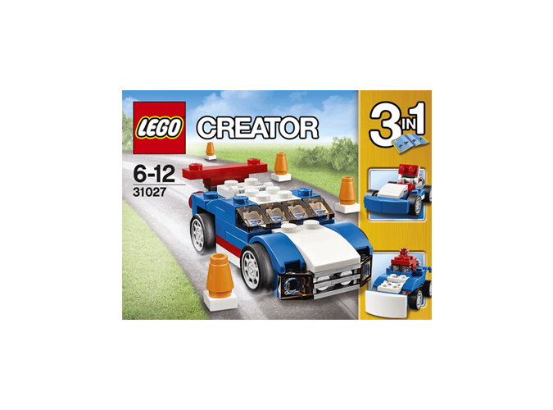
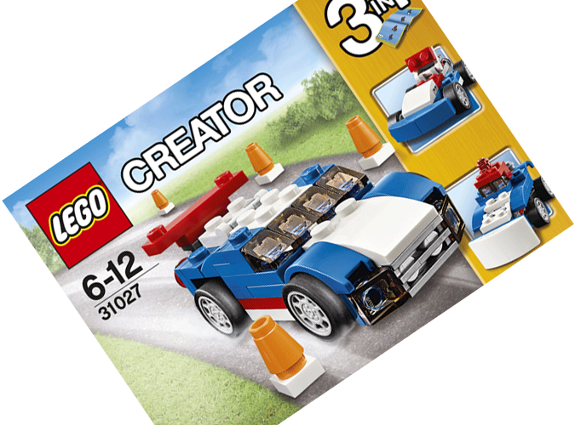
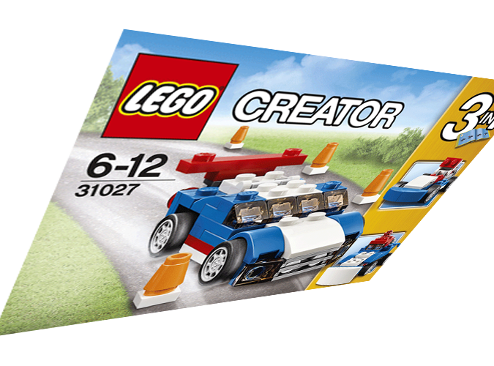
Image Preprocessing
Standard form
Scaling change
Rotation
Perspective transform
We use image preprocessing to recover the shooting box to standard form from any shooting angle and extract the area of the number.
Area of number is the area under the logo in the image.
Standard form was defined as the box surface parallel with the shooting camera and the texts are normal morphology in the image.

Slide 4
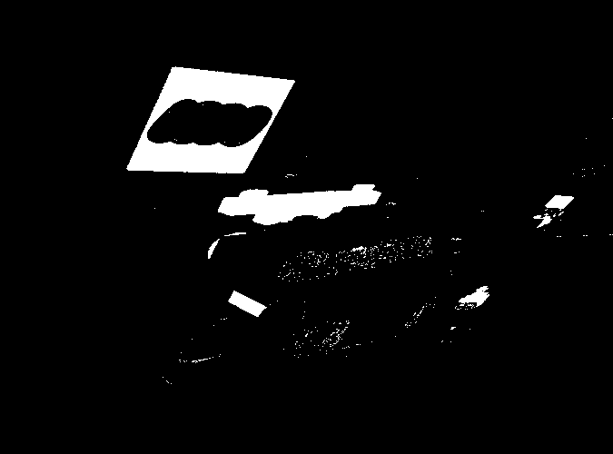
Image Preprocessing
Step1: Using HSV color space to find the red area in the image. The result is a mask.

Slide 5
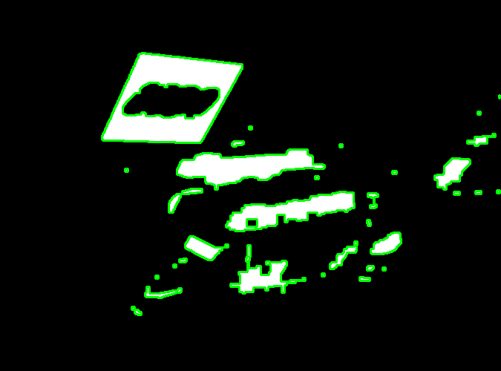
Image Preprocessing
Step 2: Finding all contours from the mask.

Slide 6
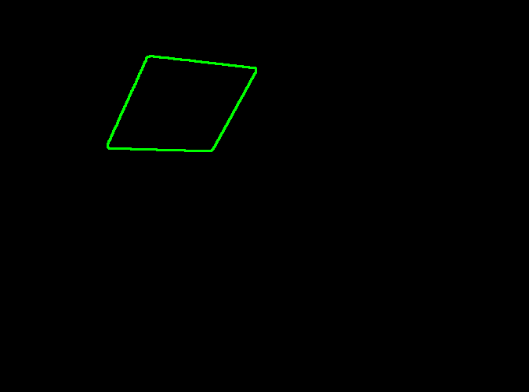
Image Preprocessing
Step 3: Picking the biggest quadrilateral from the contours by some geometric attribution.

Slide 7
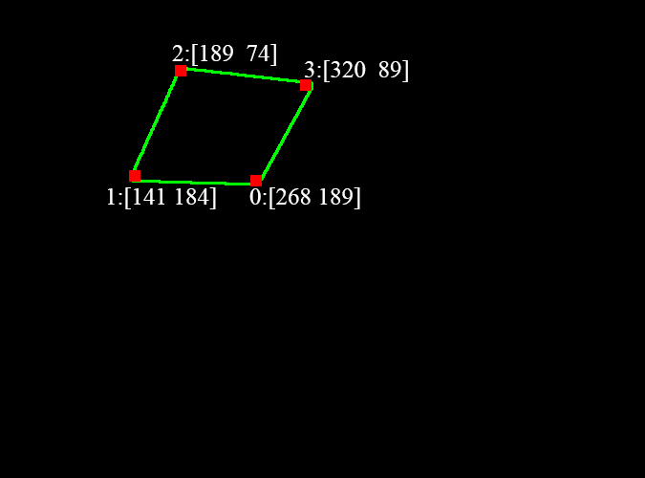
Image Preprocessing
Step 3: Detecting the four corners by Harris method. It could also verify the contour is a quadrilateral.

Slide 8
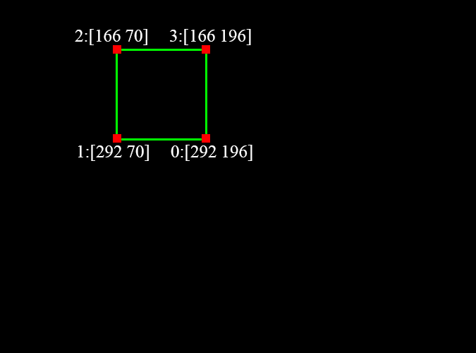
Image Preprocessing
Step 4: Creating a standard square preparing for affine transform.

Slide 9
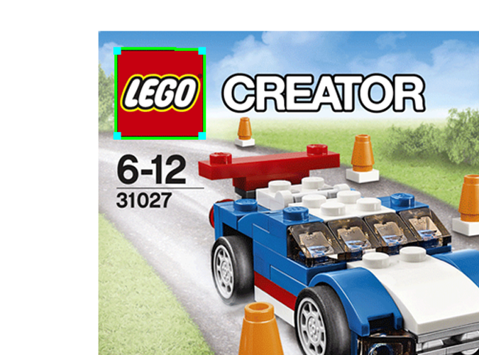
Image Preprocessing

Slide 10
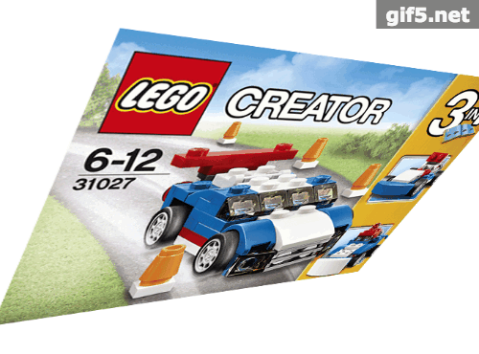
Image Preprocessing

Slide 11
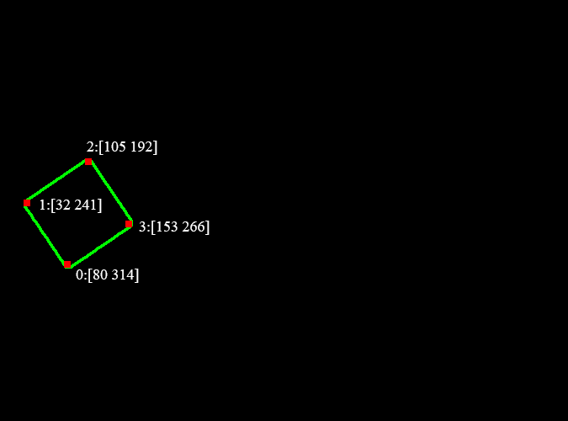
Image Preprocessing

Slide 12
Image Preprocessing
2
1
0
3

Slide 13
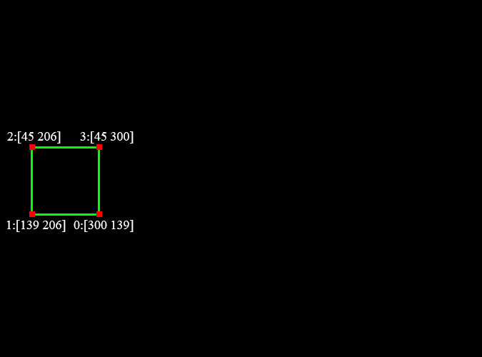
Image Preprocessing
2
1
0
3

Slide 14
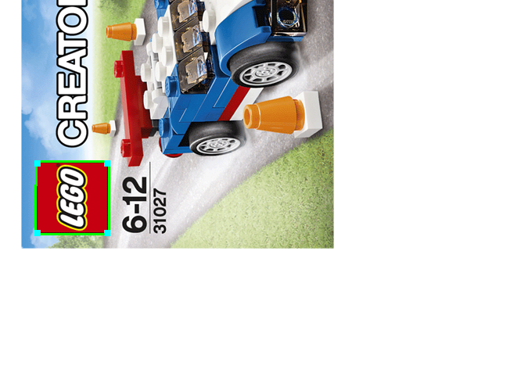
Image Preprocessing
2
1
0
3

Slide 15
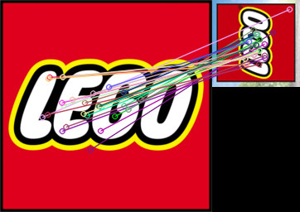
Image Preprocessing

Slide 16
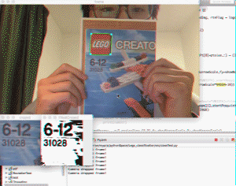

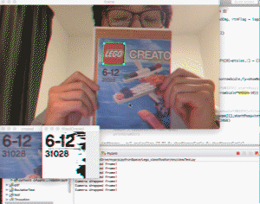
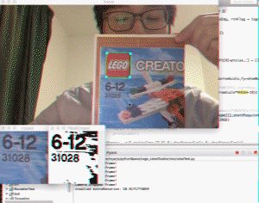
Image Preprocessing
Scaling
Rotation
Perspective
transform
Figx. Implementing result

Slide 17
Optical Number Recognition
Generate the training set
Three features – Original image, Canny image, Gradient image
Train the classifier – KNN, SVM, Random Forest
Pick the result
Pick the 5 numbers out

Slide 18



Training data
There are around 1000 samples for each number
Each number was reshaped to 16*16
Doing Canny and HOG(for the gradient) for each reshaped image
Turn the outputs to a 1*256 array.
Then we got the Training set, around 3000 samples for each number.

Slide 19
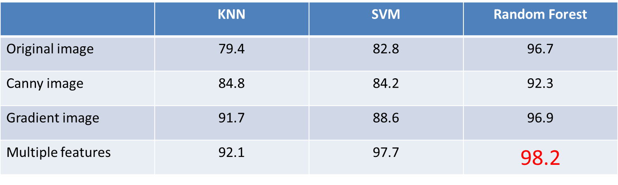
Classifier
KNN
SVM
Random Forest

Slide 20
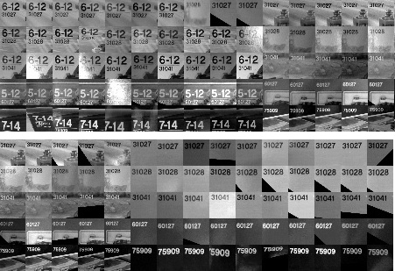
CNN Training dataset
5 boxes,
each has 6 sides
300-400 pictures per boxes, totally 1600, under different conditions
Testing dataset also
created as 100-200 pictures per box, totally 600.

Slide 21
Convolutional Neuron Network
30*30
28*28*32
14*14*32
12*12*32
6*6*32
512
256
128
64
5
Input
Convolution1
by 3*3
Maxpool
subsampling
by 2*2
Convolution2
by 3*3
Maxpool
subsampling
by 2*2
Fully
Connecting
Neurons

Slide 22
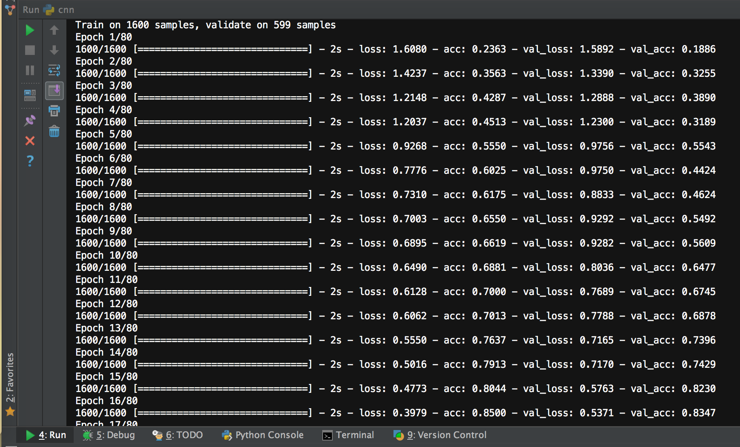
CNN Model Training
Validation accuracy reach 0.83
after 16 epochs.
The best training model we used
have:
Training Loss: 0.08
Training accuracy: 0.96
(1600 training samples)
Testing Loss: 0.17
Testing accuracy: 0.95
(600 testing samples)

Slide 23
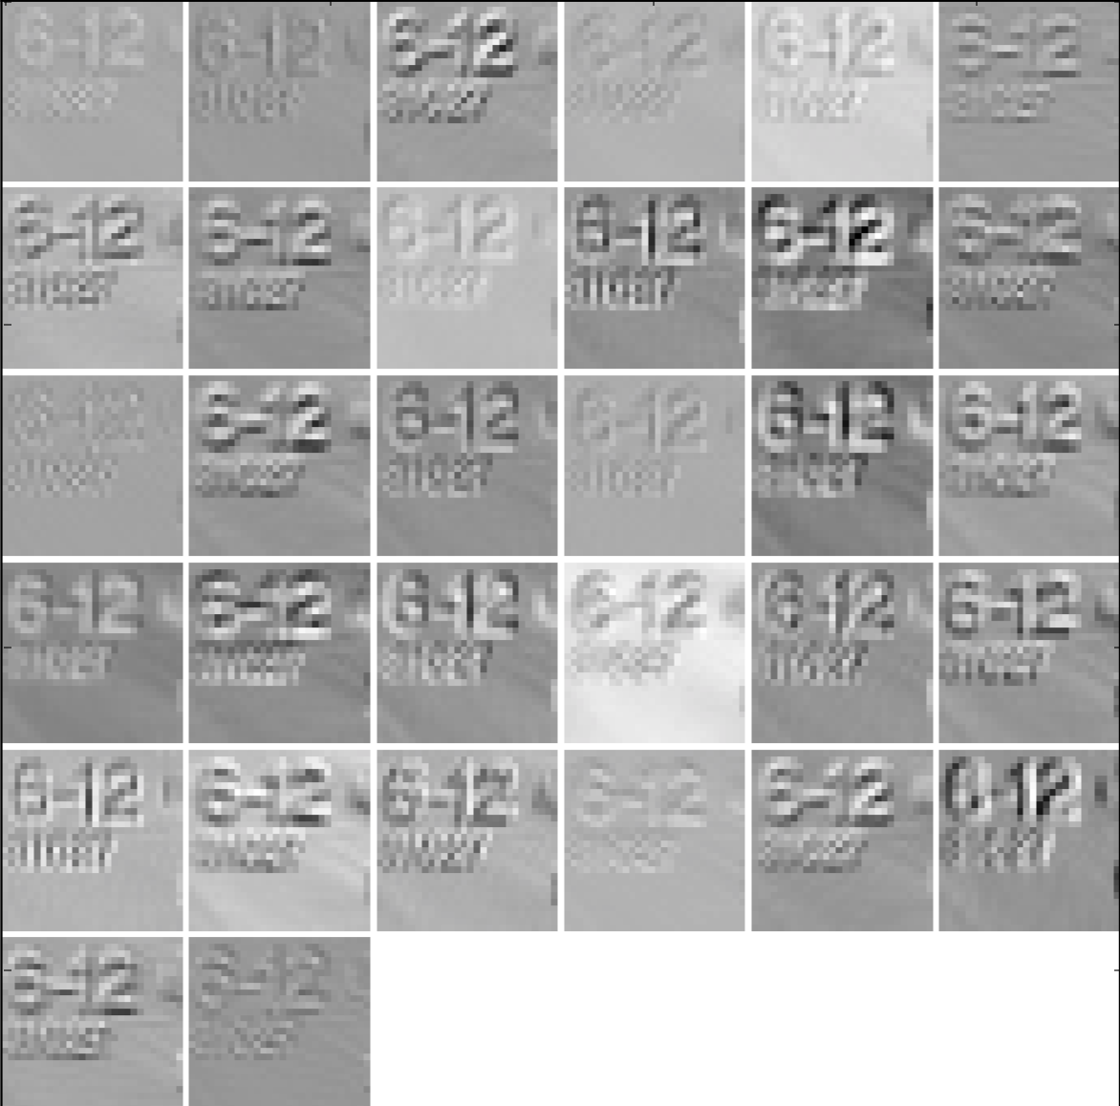
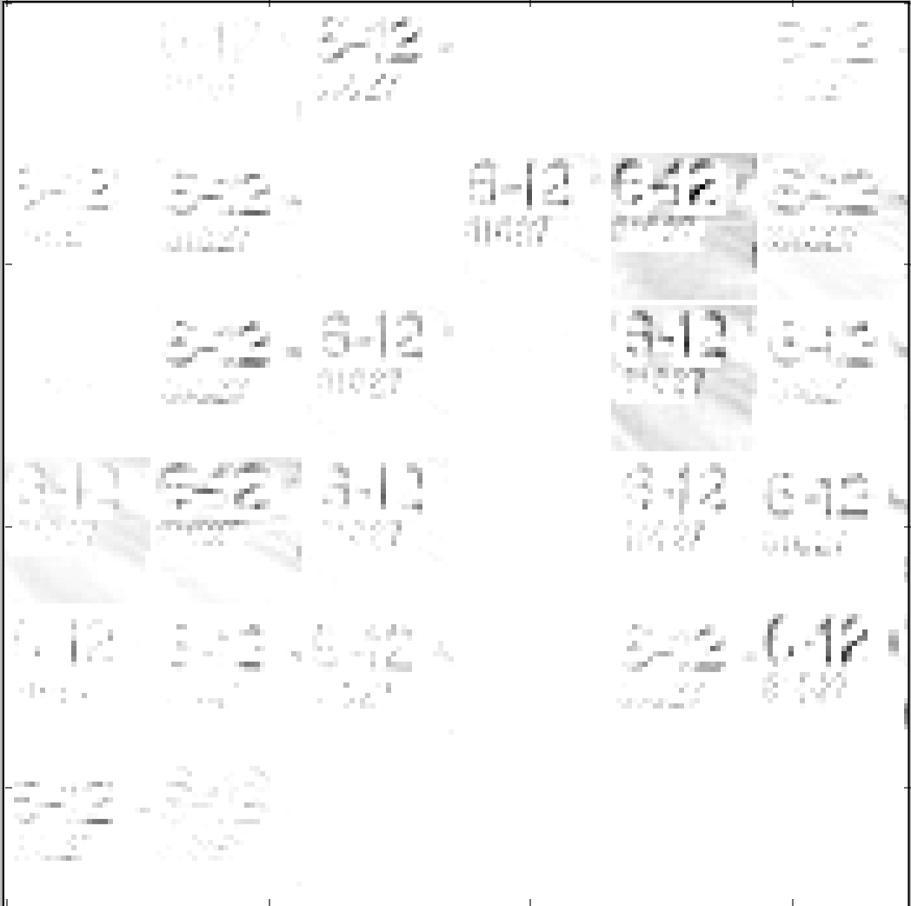
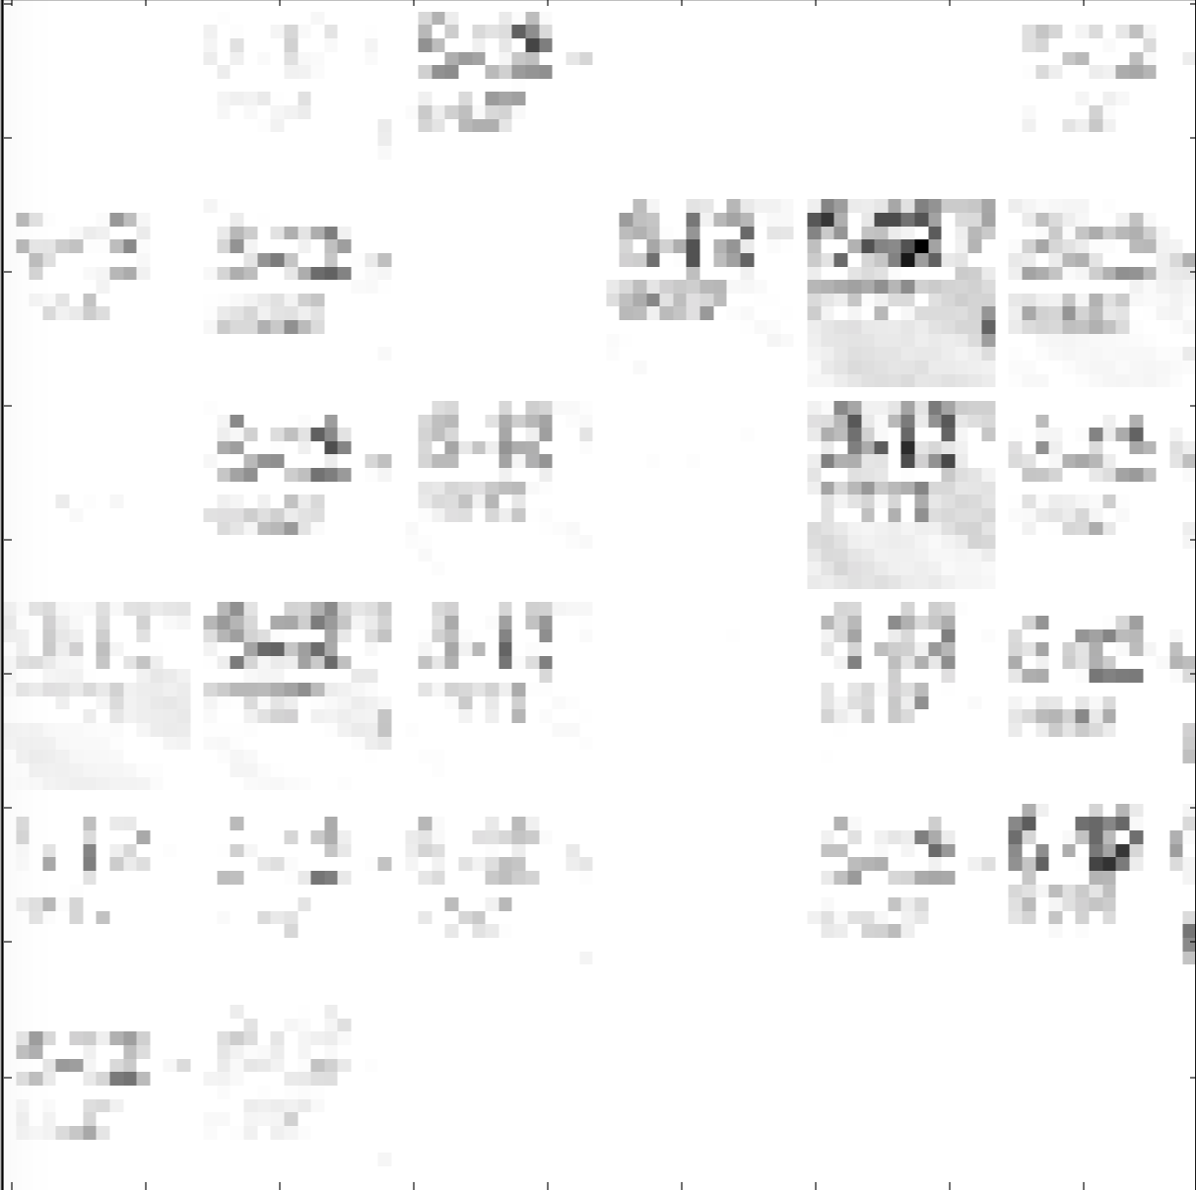
Convolution Layer results
Convolution 1
with 32 3*3 filters
RELU activation Layer
with 0.5 dropout
Max pool
with 2*2 filter size

Slide 24
External Library Used
Opencv 3.0
for image preprocessing
Keras 1.0.3 (based on theano)
for CNN model implementation
h5py 2.6.0
for CNN model written and read
Levenshtein 0.12.0
for computing string edit distances and similarities.

Slide 25
Conclusion
Although the algorithm we developed now can be light-invariant and pose-invariant, there are still many improvement can be done:
Accuracy on detection and recognition.
Move into mobile platform
By working through this project, we really learned a lot.
Image processing, like thresholding, HSV color space, heat function
KNN in Optical Character Recognition
Convolutional Neuron Network
Team cooperating on Github

Slide 26
Live Demonstration
Thank you
Please feel free to ask any questions
You are welcome to fork our project at
https://github.com/sotondriver/Lego_classification

